Slide 1
Cognitive Services Topic Deep Dive with Azure ML Anomaly Detection
with Demos/HOLs
Presenter: Anusua Trivedi

Slide 2
What you’ll know at the end of this session
How to use the API Reference for Cognitive Services Entity Linking Intelligent Service (ELIS)
What Cognitive Services Text Analytics API detectors entail
How to interface programmatically with Azure ML Anomaly Detection
How to create a model with Cognitive Services Language Understanding and Intelligent Service (LUIS)

Slide 3






Powering products across Microsoft
Intelligence powers our products
Vision
Speech
Language
Knowledge
Search

Slide 4
Cognitive Services Entity Linking Intelligent Service (ELIS)

Slide 5
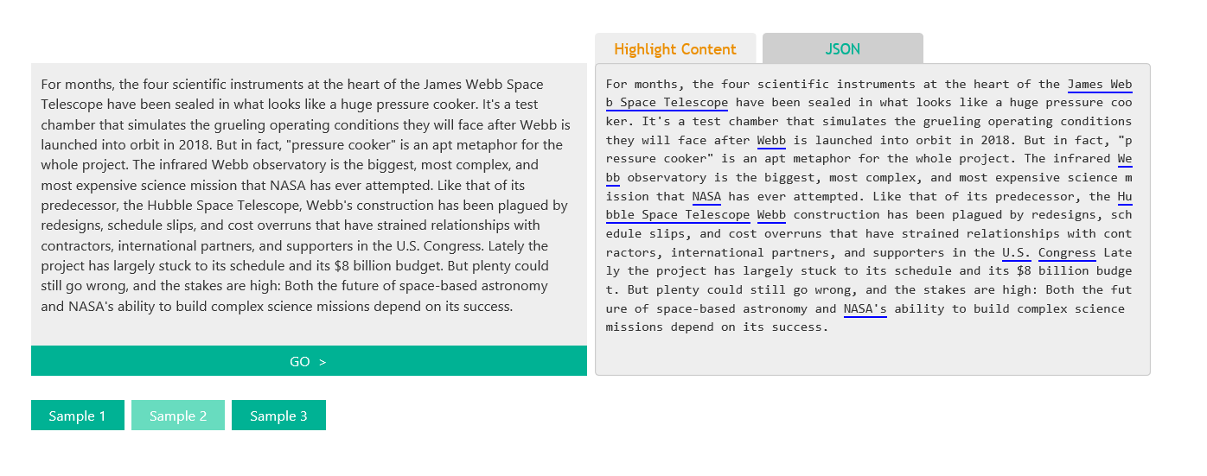
Entity Linking Intelligent Service (ELIS)
Notes:
Docs: https://www.microsoft.com/cognitive-services/en-us/entitylinking-api/documentation/overview
Getting started: https://www.microsoft.com/cognitive-services/en-us/entitylinking-api/documentation/GettingStarted

Slide 6
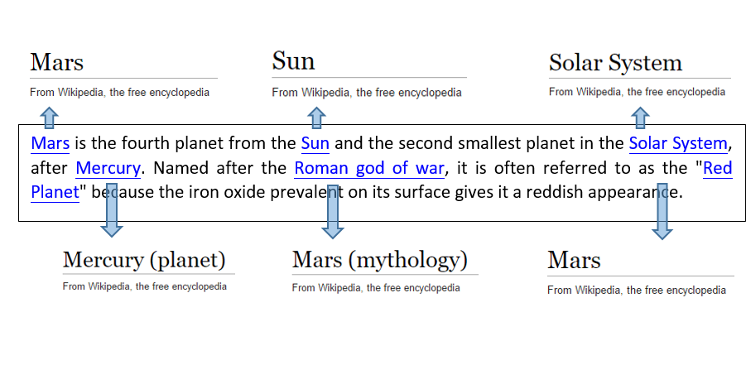
ELIS – Identifying from context

Slide 7
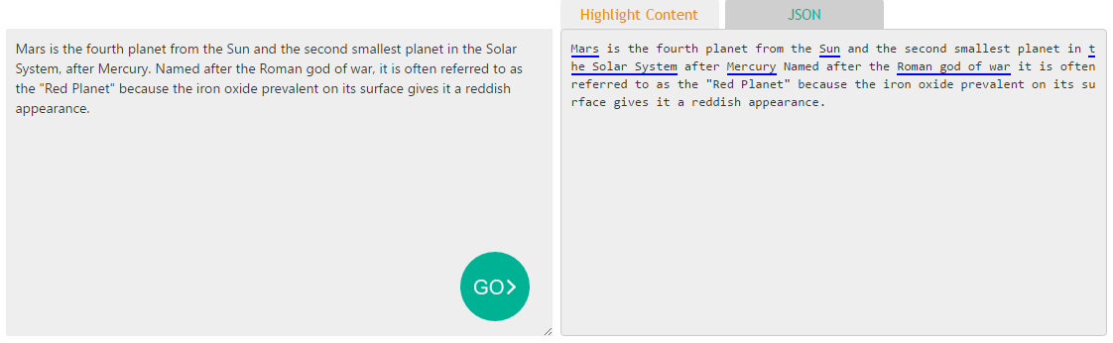
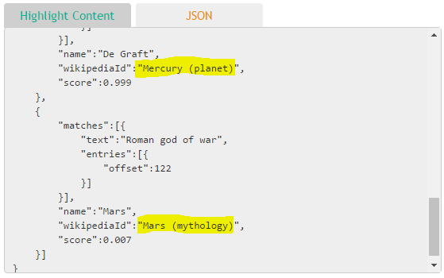
ELIS Response
Notes:
(entity linking)

Slide 8
ELIS Demo
Notes:
Obtaining the subscription and using the API Reference (follow along if you like):
Go to: https://www.microsoft.com/cognitive-services/en-us/documentation
Go to: My account (upper right corner)
Request new trials
Select “Entity Linking”, Agree, Subscribe
Once you have a subscription to a service, if you go back to Documentation page, click ELIS drop-down
Go to: API Reference
This is where you’ll find technical info like the Request URL, params, and response, etc. Plus code samples in many programming languages.

Slide 9
Cognitive Services Language Text Analytics API

Slide 10
Text Analytics - Detectors
Sentiment - Is text positive or negative?
Key phrases - What are people discussing in a single article?
Topics - What are people discussing across many articles?
Languages - What language is text written in?
Notes:
Notes:
Language – 120 languages available as labels
Key phrase – talking points, English only currently
Topic detection – identify main topics over several articles, will need at least 100 documents as input
Nice quick start guide: https://azure.microsoft.com/en-us/documentation/articles/cognitive-services-text-analytics-quick-start/
Tip: for sentiment analysis it’s a good idea to split text into sentences to gain higher precision.
For a Bot example leveraging text analytics see: http://docs.botframework.com/en-us/bot-intelligence/language/#example-emotional-bot
key phrases e.g. ‘different country’ and ‘common phrases’ in the sentence ‘When I travel to a different country, I always like to try to learn how to say common phrases like hello and thank you.’
topic e.g. id main issues in user feedback forms
key phrase and sentiment currently support English, Spanish, German and Japanese

Slide 11
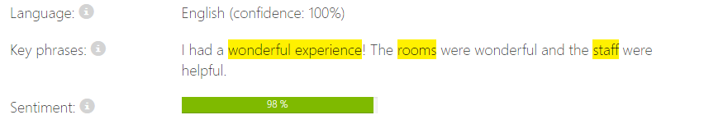
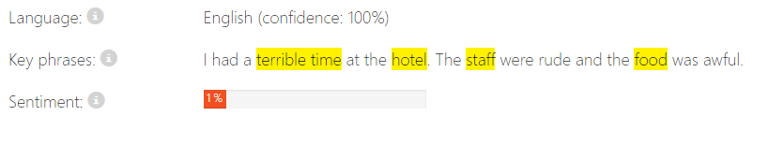
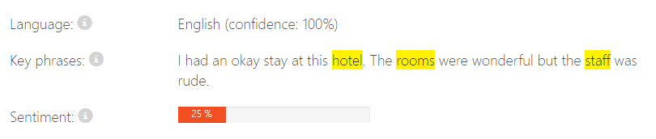
Text Analytics Examples
Example 1:
Example 2:
Example 3:

Slide 12
Text Analytics Demo
Notes:
https://text-analytics-demo.azurewebsites.net/
Another resource:
API Demo - https://text-analytics-demo.azurewebsites.net/Home/SampleCode
Also, check out the API Reference site for this API by clicking on this link on the Documentation page

Slide 13
Azure ML Anomaly Detection
Notes:
General Azure ML docs: https://azure.microsoft.com/en-us/documentation/services/machine-learning/

Slide 14
Anomaly Detection with Azure Machine Learning APIs
When is it good to have an anomaly detection service?
Notes:
Please, share your thoughts with the class.

Slide 15
When is it good to have an anomaly detection service?
Perhaps to watch out for:
Too many login failures
Spikes or dips in customer checkouts
An increase in the dynamic range of file ingestion speeds
in a cloud service
An upward trend in system temperature
Notes:
These are cases found from monitoring a system where a closer look may be called for. They are indicative of abnormal or anomalous behavior and could indicate a problem. The data could be streaming from a device or come from log files, but no matter the source an anomaly detection model could help predict when a system needs to be examined further.

Slide 16
The AML Anomaly Detection API Detection Categories
Positive and negative trends
Changes in the dynamic range of values
Spikes and Dips
Notes:
These machine learning detectors track such changes in values over time and reports ongoing changes in their values as anomaly scores. They do not require adhoc threshold tuning and their scores can be used to control false positive rate.
Some more scenarios are:
service monitoring by tracking KPIs over time, usage monitoring through metrics such as number of searches, numbers of clicks, performance monitoring through counters like memory, CPU, file reads, etc. over time.

Slide 17
The AML Anomaly Detection API has Two Models
Score API
ScoreWithSeasonality API
Notes:
The Score API is used for running anomaly detection on non-seasonal time series data.
The ScoreWithSeasonality API is used for running anomaly detection on time series that have seasonal patterns. This API is useful to detect deviations in seasonal patterns.
The APIs run a number of anomaly detectors on the data and returns their anomaly scores.

Slide 18
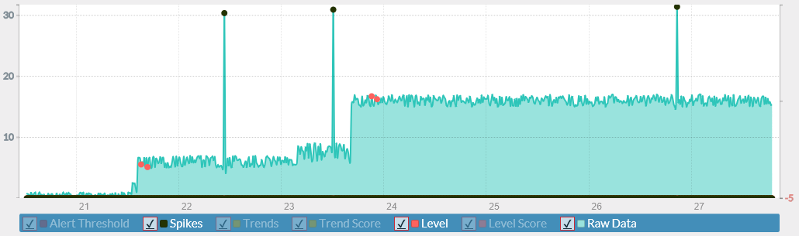
AML Anomaly Detection Score API
Figure representing common input data (time series, non-seasonal)
Notes:
This time series has 2 distinct level changes, and 3 spikes. The red dots show the time at which the level change is detected, while the black dots show the detected spikes.
We’d use the
Level change detectors
Spike detectors

Slide 19
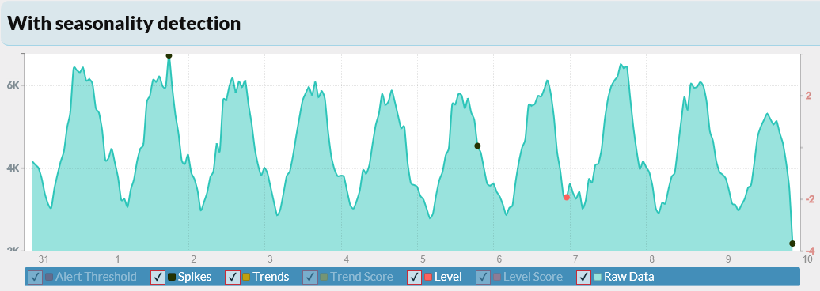
AML Anomaly Detection ScoreWithSeasonality API
Figure representing common input data (time series, seasonal)
Notes:
The time series has one spike (the 1st black dot), two dips (the 2nd black dot and one at the end), and one level change (red dot).
We’d use the
Level change detectors
Spike detectors (it’s actually for spikes and dips)
Note that both the dip in the middle of the time series and the level change are only discernable after seasonal components are removed from the series.

Slide 20
AML Anomaly Detection Lab
On Jupyter Notebooks
Notes:
Instructions for getting to notebook:
1. This is where you will use the DSVM username and password on the slip of paper
2. Go https://aka.ms/botnotebooks You may encounter a certificate error in the browser you are in, but rest assured this is expected behavior right now.
On chrome: Click “Advanced” and then “proceed to….”
On IE: “Continue to this website”…
3. Use the credentials to log in to jupyter
4. Navigate to the “cogservices_samples” folder
5. Go to the AnomalyDetection.ipynb
Save your work as you go and it will persist and, note, you do not have to download anything until the VM is pulled down on Sept. 5 at EOD PST)
Submit bugs, errors, any problems to the email michhar@microsoft.com (Micheleen Harris)

Slide 21
Cognitive Services Language Understanding Intelligent Service (LUIS)

Slide 22
LUIS Concepts
Intent – aim or goal
Entities – a type or “notion” of person, place or thing
Utterances – the phrase we might use that is added training data
Notes:
Utterances
If you have unlabeled utterances that your application should handle, they will be available when you edit the application under the "Search" and "Suggest" tabs.
Can link intents to actions and specify requirements for the action
Export LUIS app
Can download your work into a JSON file. This lets you share you application with other developers, or check your LUIS application into your version control.
Pre-Built:
LUIS also provides access to pre-built LUIS applications that use many of the same models found in Microsoft Cortana.
example:
intent – find news on topic and possibly share with another person
entities - We'd like to be able to say what kind of news we are interested in, and also, for sharing, to say who we'd like to share a story with. In order to capture the notion of a news topic, and a recipient for sharing, let's create two entity types: "Topic" and "Recipient".

Slide 23
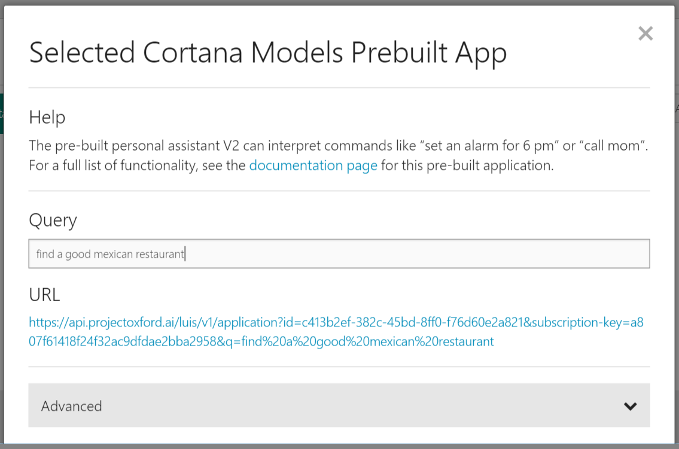
Pre-built LUIS Cortana model
Just save id and key to use in app

Slide 24
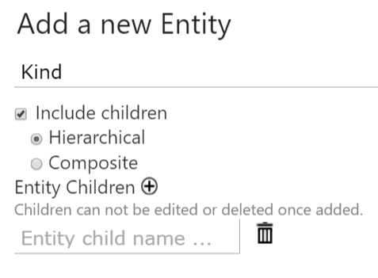
LUIS Concepts - Entities
Hierarchical entities – entity that inherits from other entities (start date and end date can inherit from the general date entity)
Composite entities - an entity that is form of a set of existing entities (e.g. a ticket entity as a composite of count and class)
Notes:
hierarchical entities - The generic entity acts as the parent and the children are the specific types, or sub-groups, under the parent, yet both share the same characteristics. e.g. Date (Start Date and End Date)
composite - In a flight booking app, a user may say “Book 2 adult tickets to Paris next Monday”. In this example, we may create a composite entity called “Tickets”, including the component entities “number” and “category” to capture the number and category of tickets to be booked. If not already existing, you need to define both entities before defining the composite.

Slide 25
LUIS - Training
When you "train" a model, LUIS generalizes from the examples you have labeled, and develops code to recognize the relevant intents and entities in the future
Notes:
Internally, LUIS uses logistic regression classifiers to determine intents, and conditional random fields (CRFs) to determine the entities. The training process results in optimized classifiers and CRFs, referred to as models, that LUIS can use in the future.

Slide 26

Language Understanding Intelligent Service
Vision
Read me the headlines
Intent: TextToSpeech
Content: NewsHeadlines
Understand what your users are saying
Determines intent
Detects entities
Seamless integration with Speech Recognition
Learns over time
Use pre-built, world class models from Bing and Cortana
Play yesterday’s Daily Show
Intent: PlayEpisode
Content: Daily Show
DateTime.date: T-1 Day
Pause for 5 minutes
Intent: PauseDevice
DateTime.duration: 5 Minutes

Slide 27
Demo of creating LUIS model in Web UI
Notes:
https://www.luis.ai/ - create an app here (a model that’s used for intents in natural language later on)
https://www.luis.ai/Help#CreatingApplication - for a complete guide on creating a LUIS model and app for consumption
Note that sentences longer than 500 characters will result in an error message.
The sentences that LUIS receives are automatically logged for future use.
LUIS returns a JSON object, with fields and scores for each of the entities and models you have created
- all on the help like above

Slide 28
Documentation
https://www.microsoft.com/cognitive-services/en-us/documentation
Client SDKs
https://www.microsoft.com/cognitive-services/en-us/sdk-sample
​​​
Example Code
https://text-analytics-demo.azurewebsites.net/Home/SampleCode
(On all API References as well)
Developer Resources
Notes:
Access to strong documentation, sample code and community resources is critical for developers to be able to understand and become users of Cognitive Services. Customize these links based on your own resources or use the ones listed here.

Slide 29
Demos and Featured Apps
https://www.microsoft.com/cognitive-services/en-us/applications
https://www.captionbot.ai/
https://www.microsoft.com/cognitive-services/en-us/speech-api
https://www.microsoft.com/cognitive-services/en-us/speaker-recognition-api
https://www.microsoft.com/cognitive-services/en-us/bing-spell-check-ap
https://github.com/Microsoft/Cognitive-Samples-IntelligentKiosk/i
(and many more)
Join Our Community
https://stackoverflow.com/questions/tagged/microsoft-cognitive
https://social.msdn.microsoft.com/forums/azure/en-US/home?forum=mlapi
https://cognitive.uservoice.com/
Pricing
https://www.microsoft.com/cognitive-services/en-us/pricing
Additional Resources
Notes:
Access to strong documentation, sample code and community resources is critical for developers to be able to understand and become users of Cognitive Services. Customize these links based on your own resources or use the ones listed here.

Slide 30
Questions

